Slide 1
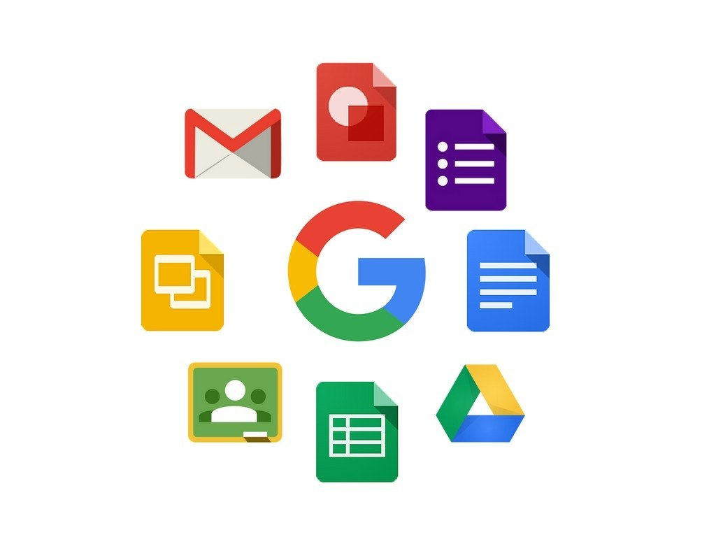
Google app

Slide 2
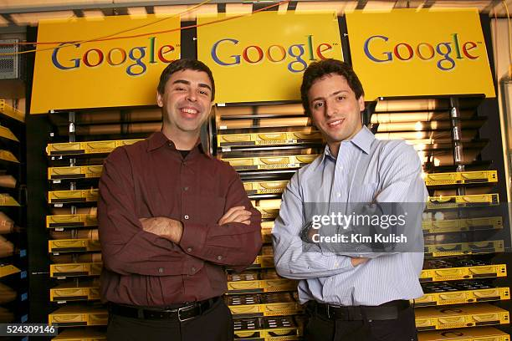
Google LLC is an American multinational technology corporation focused on information technology, online advertising, search engine technology, email, cloud computing, software, quantum computing, e-commerce, consumer electronics, and artificial intelligence.

Slide 3

Google workspace
Google Workspace includes the productivity apps you know and love—Gmail, Drive, Docs, Meet, and many more—in one location, so you can create, communicate, and collaborate.

Slide 4

How google apps are useful?
Google apps are helpful because they simplify and enhance everyday tasks by providing tools for communication, organization, information access, and collaboration.
These apps are generally free, accessible from multiple devices, and designed to work together seamlessly, boosting productivity for individuals and organizations.

Slide 5
Google apps

Slide 6
Gmail
Gmail is a popular, free, and web-based email service provided by Google that allows users to send and receive digital messages, files, and other information over the internet.
Key features
Centralized storage
Built-in chat and call functions
Advanced spam filtering
Automatic saving of work.

Slide 7
Google drive
Google Drive is a cloud-based storage platform provided by Google that allows users to store, access, and share their files and documents from anywhere with an internet connection..

Slide 8
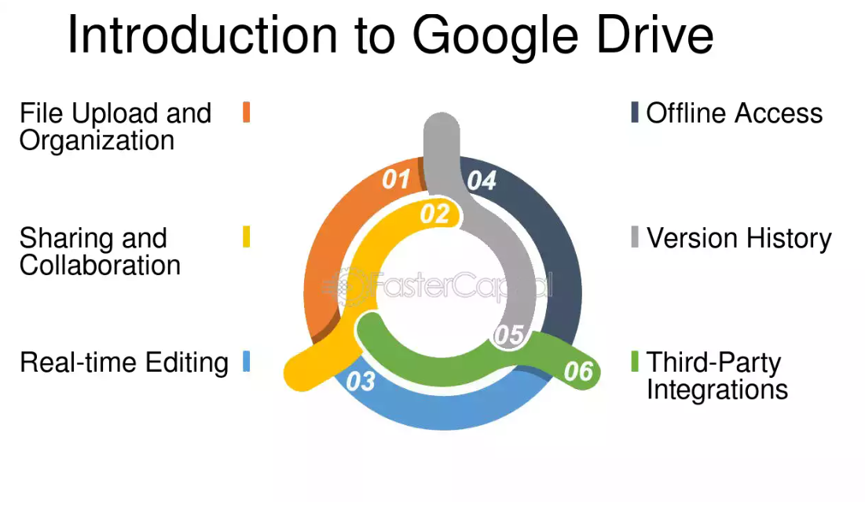

Slide 9
Google map
Google Maps is a web-based service by Google and app that provides detailed mapping, satellite imagery, and navigation for planning routes via various modes of transport.
Key features
Mapping & Navigation:
Street View:
Satellite Imagery & Aerial Photography:
Real-Time Traffic:
Local Business Information:
Accessibility:
Route Planning:

Slide 10
Google docs
Google Docs is a free, web-based word processor that allows users to create, edit, and collaborate on documents online in real-time
Key features
Real-time Collaboration:
Cloud-Based Storage:
Voice Input:
Suggesting Mode:
AI-Powered Assistance (Gemini):

Slide 11
Google sheets
Google Sheets is a free, web-based spreadsheet application for organizing and analyzing data. Users can create, edit, and share spreadsheets through a web browser or mobile apps, and the service is compatible with Microsoft Excel files.
Key features
Collaborative editing
Cloud-based storage
Accessibility
Functionality
AI-powered tools
Compatibility:

Slide 12
Google slides
Google Slides is a free, cloud-based presentation software for creating and editing slideshows online.
Key features
Cloud-based and collaborative
Accessible from anywhere
Free
Content Creation and formatting
Animation and transitions
Template gallery
File compatibility
Sharing and permission

Slide 13
Google calendar
It keeps track of our personal appointments, schedule aur meetings , conferences, event, etc with our team and set reminders and also helps to synchronize our future appointments with the rest of the team.it can be shared with others also.

Slide 14
Google meet
Google Meet is a video communication service developed by Google that allows users to have virtual meetings through video, audio, and screen sharing

Slide 15
Google contacts
Google Contacts is a digital address book service that stores and organizes contact information for people and companies. It can store up to 25,000 contacts.

Slide 16
Google photos
Google Photos is a photo and video storage and sharing service that provides automatic cloud backups, organization tools, and creative editing features. It automatically organizes your media into a timeline, creates albums and "memories," and uses AI to help you search for specific content, people, or places.

Slide 17
Google classroom
Google Classroom is a free, online collaboration tool developed by Google that helps teachers manage classes, assignments, and communication, and helps students stay organized

Slide 18
Google forms
Google Forms is a free, web-based tool for creating surveys, quizzes, and other online forms. It allows users to gather information from others, analyze responses in real-time. Responses can be automatically organized in a Google Sheet for easy analysis.

Slide 19
Google earth
Google Earth is a computer program that renders a 3D representation of Earth based on satellite imagery, aerial photography, and GIS data

Slide 20
Google translate
Google Translate is a free service from Google that translates text, speech, and documents between over 100 languages using neural machine translation. Users can input text directly, use their camera to translate images, or have conversations translated in real-time.

Slide 21
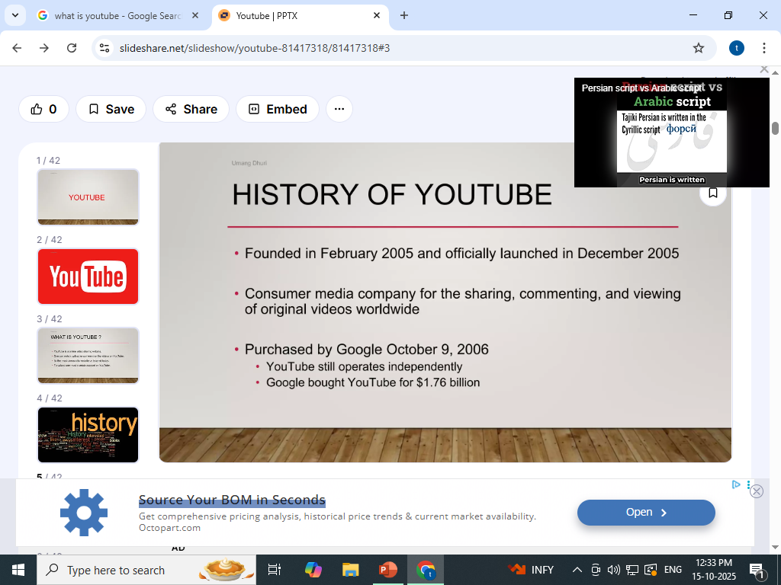
youtube

Slide 22

Thank you
Brita Tamm
502-555-0152
brita@firstupconsultants.com
www.firstupconsultants.com

